Slide 1

Dental Rounds
Fall 2018
D4 Orientation

Slide 2
What I learned as an instructor and wish I had known in dental school…
Best ways to learn:
Learn as though I was going to teach the topic
  Do your homework: read references, access resources
  Write: make a handout, an outline
  Illustrate: use pictures and graphs, draw
  Talk: review the topic with peers
When I don’t understand a concept: ask questions
  Make up exam questions
Use cases to illustrate your topic → case based learning

Slide 3
Dental Rounds
Case-based learning, solving a clinical question
Student presentations in small groups
  5 teams of 4 students
  1 team presents, observers post questions
  Group Leader and specialist
Vertical teams (D1-D4)
  Each team member assignment matches level of academic and clinical development
Goals:
  Integrate basic science and clinical practice
  Establish evidence-based approach to clinical decision making
  Incorporate all dental specialty and disciplines in practice

Slide 4
Dental Rounds formats
Fall Semester: Evidence-Based Rounds
  Student case presentations
  Address a specific clinical problem
  Apply scientific evidence in developing solutions to the specific problem
Spring Semester: Treatment-Planning Rounds
  Student case presentations
  Comprehensive treatment planning
  Evidence: Clinical Practice Guidelines
  Grand Rounds
Summer Term:
  Lessons Learned Rounds
  Faculty case presentations

Slide 5
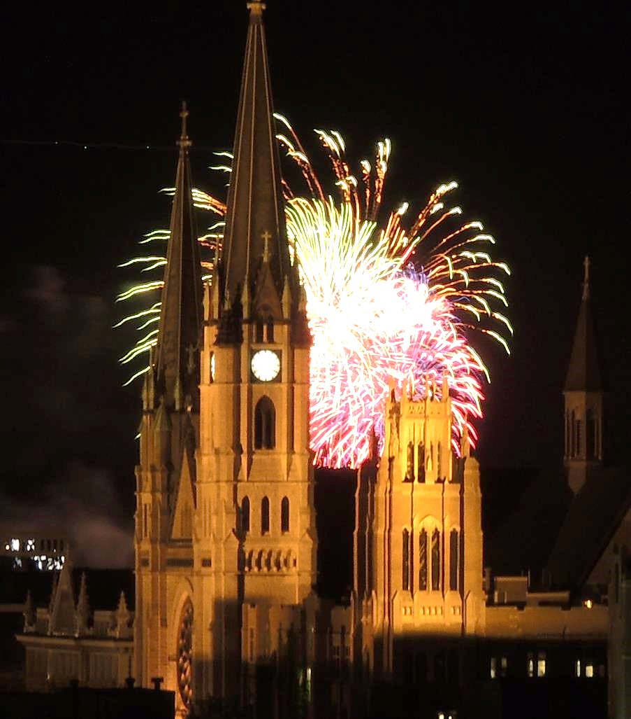
EVIDENCE BASED DENTAL ROUNDS
Fall 2018

Slide 6

MUSoD Vision
Truly integrated Predoctoral curriculum
Connections between knowledge and skills from different disciplines
Link between basic science knowledge and clinical application of science
Bridge in the development of the competent practitioner
Vertical team approach involves students from all 4 years who form teams that work with clinical cases together.
This Photo by Unknown Author is licensed under CC BY-SA

Slide 7
What is Evidence Based Dental Practice?
Best Current Scientific Evidence
Clinical Expertise
Patient’s Values & Preferences
ADA: “an approach to oral healthcare that requires the judicious integration of systematic assessments of clinically relevant scientific evidence, relating to the patient’s oral and medical condition and history, with the dentist’s clinical expertise and the patient’s treatment needs and preferences.”
Scientific evidence: foundation for clinical practice, but alone, is not enough.
Process of EBD:
Start
Questions raised in clinical practice
Seek evidence-based solutions
Format searchable clinical question
Search for best available evidence to answer the question
Critically appraise the evidence & apply it to clinical case scenario
EBD
ADA Center for Evidence-Based Dentistry. About EBD. http://ebd.ada.org/en/about

Slide 8
Benefits
D1: As you transition into the role of a dental student, understand the connections between D1 basic science knowledge to clinical cases. Normal structures and function. You are in the best position to understand the position of the patient, and to therefore ask relevant questions.
D2: understand the management of a patient presenting with structural and/or functional abnormalities. Coordinate with and mentor the D1.
D3: learn an essential skill to access and keep up with the vast and exponentially changing knowledge base. Learn to critically appraise the evidence, and communicate its significance to the patient. Balance evidence with clinician experience and patient preferences/ability to accept treatment.
Are the study findings reliable? Decide whether the studies have been undertaken in a way that makes their findings reliable? Can you make sense of the results? Doyou know what the results mean in the context of your decision-making?
D4: develop leadership skills in managing a team to address a clinical question relevant to a specific patient.

Slide 9
Rounds Team Responsibilities
Your case presentation
PLUS:
You are expected to attend all 4 remaining Rounds presentations within your assigned Rounds Group
  Approx. 20 students, 5 teams of 4 students
  (Some teams will have an extra student)
On the Rounds Website, you are expected to:
Review case materials posted for each presenting team in your Rounds Group
Post a question related to the other teams cases PRIOR TO their presentation
Select one journal article from any observed presentation to review, summarize and complete a classification of the journal type and study design

Slide 10
Team Presentation
D3: PICO question
  Evidence-based approach (10 min)
  Literature review – presents the scientific evidence behind proposed solutions to the clinical problem
  Critical appraisal: weigh the strength of the evidence
Discussion – Students, Specialist, Group Leader (20 min)
  Address questions posted by observers
  What is the significance of the evidence to this case?
  How to advise the patient in treatment choices?
  Weighing the evidence, clinicians’ experience, patient circumstances & preferences
D4: Team leader
  Presents the clinical case (10 min)
  Patient of record with a specific problem
D1: Basic Science aspect of the case
  (5 min)
  Normal form and function as it relates to the patient’s problem
D2: Pathology aspect of the case
  (5 min)
  Addresses the abnormality, disease process related to the patient’s problem

Slide 11
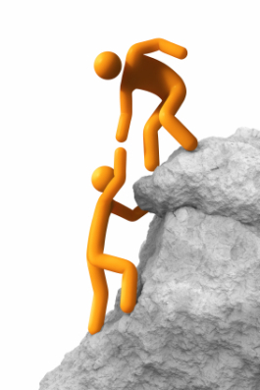
D4 Team Leader Responsibilities
Oversees the vertical team
Selects the case and topic area
Contacts and works with:
  Their D1, D2, D3 team members
  Specialist faculty
Assigns clinical question, pathology, and basic science questions
May provide, or guide students to, reference materials
Compiles and posts the PowerPoint presentation, incorporating team member slides
This Photo by Unknown Author is licensed under CC BY-NC-ND

Slide 12
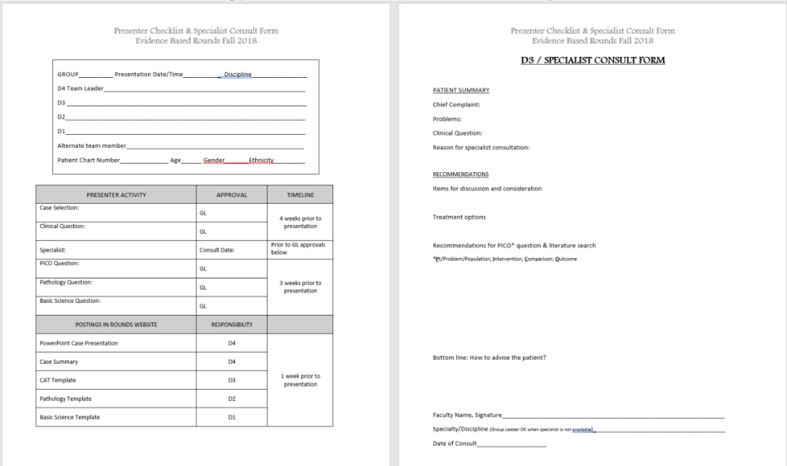
Checklist
For D4’s
Consult Form
For
D3’s
Download from Rounds Website

Slide 13
D4 Responsibilities – as Presenters
Case presentation (<10min)
Diagnostic data
  Medical / dental Hx
  Clinical & radiographic findings
  Odontogram, clinical photos, radiographs, casts
Answer questions, participate in discussion with faculty and observers

Slide 14
Timelines – postings are time/date stamped
-- 10% grade reduction for each late posting
PRESENTER ACTIVITY | EXPECTED TIMELINE
GL approves: case selection & clinical question | 4 weeks before presentation
GL approves: basic science, pathology & PICO questions | 3 weeks before presentation
Post in Rounds Website: PowerPoint case presentation CAT template Pathology template Basic science template | 1 week before presentation
OBSERVER ACTIVITY | EXPECTED TIMELINE
Review case materials | Prior to presentation
Post discussion question | 2 days prior to presentation
Post classification of evidence from one article | Not more than 2 business days AFTER the LAST group presentation.

Slide 15
Resources
Presentation & Observation
Administrative
Your Group Leader & Course Director
Your specialist faculty
MUSoD Rounds Website
Syllabus
Articles & templates, PPT are built into the Rounds Website:
http://www.musod.org/rounds/login.php
Course Director
  Dr. Cimrmancic
  Room 336H
  288-0791
Attendance & Scheduling
  Your Group Leader
  Course Director
  Ms. Catherine Porter
  Mr. Tom Wirtz
Website issues
  Mr. Tom Wirtz

Slide 16
D1 - 4 Responsibilities – as Observers
Attend all 4 Rounds presentations within your assigned group
In advance:
  Review posted materials
  Post questions related to any aspect of the observed cases prior to their presentations
Select 1 journal article from any observed presentation
  Review & summarize
  Complete a classification of the journal type and study design

Slide 17
Rounds attendance and participation
You are expected to come to Rounds each session, prepared to participate.
Late attendance will result in a half letter grade penalty.
Missing a Rounds session (>15 min. late) will result in a full letter grade reduction and also require attendance at another Rounds session approved by your Group Leader.

Slide 18
Select your case & topic
Contact your D1
Confer with your team
And: Group Leader
Specialist
Course Director

Slide 19


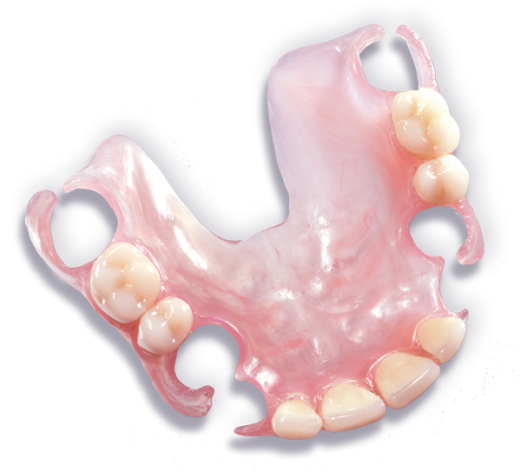
TOPICS
Interesting, timely issues
Classic topics
Emerging topics
The What-if scenario
Work with your GL, specialist, Dr. C
This Photo by Unknown Author is licensed under CC BY-NC-SA

Slide 20
Dental Rounds as a laboratory for applied research, case-based learning. Presentation and discussion. Where clinicians are made…
GP as the quarterback of a case.
Specialists as the resources.
  Private practice: patient is referred to specialist(s) for opinions on treatment options. GP and patient evaluate those opinions and options and decide on course of treatment. Opinions may or may not be consistent. What to do?
  Critical thinking
  Evidence Based Dentistry – scientific evidence, clinician experience, patient preferences and ability to proceed with tx.
What to do with the information as it pertains to advising the patient in making treatment decisions?

Slide 21
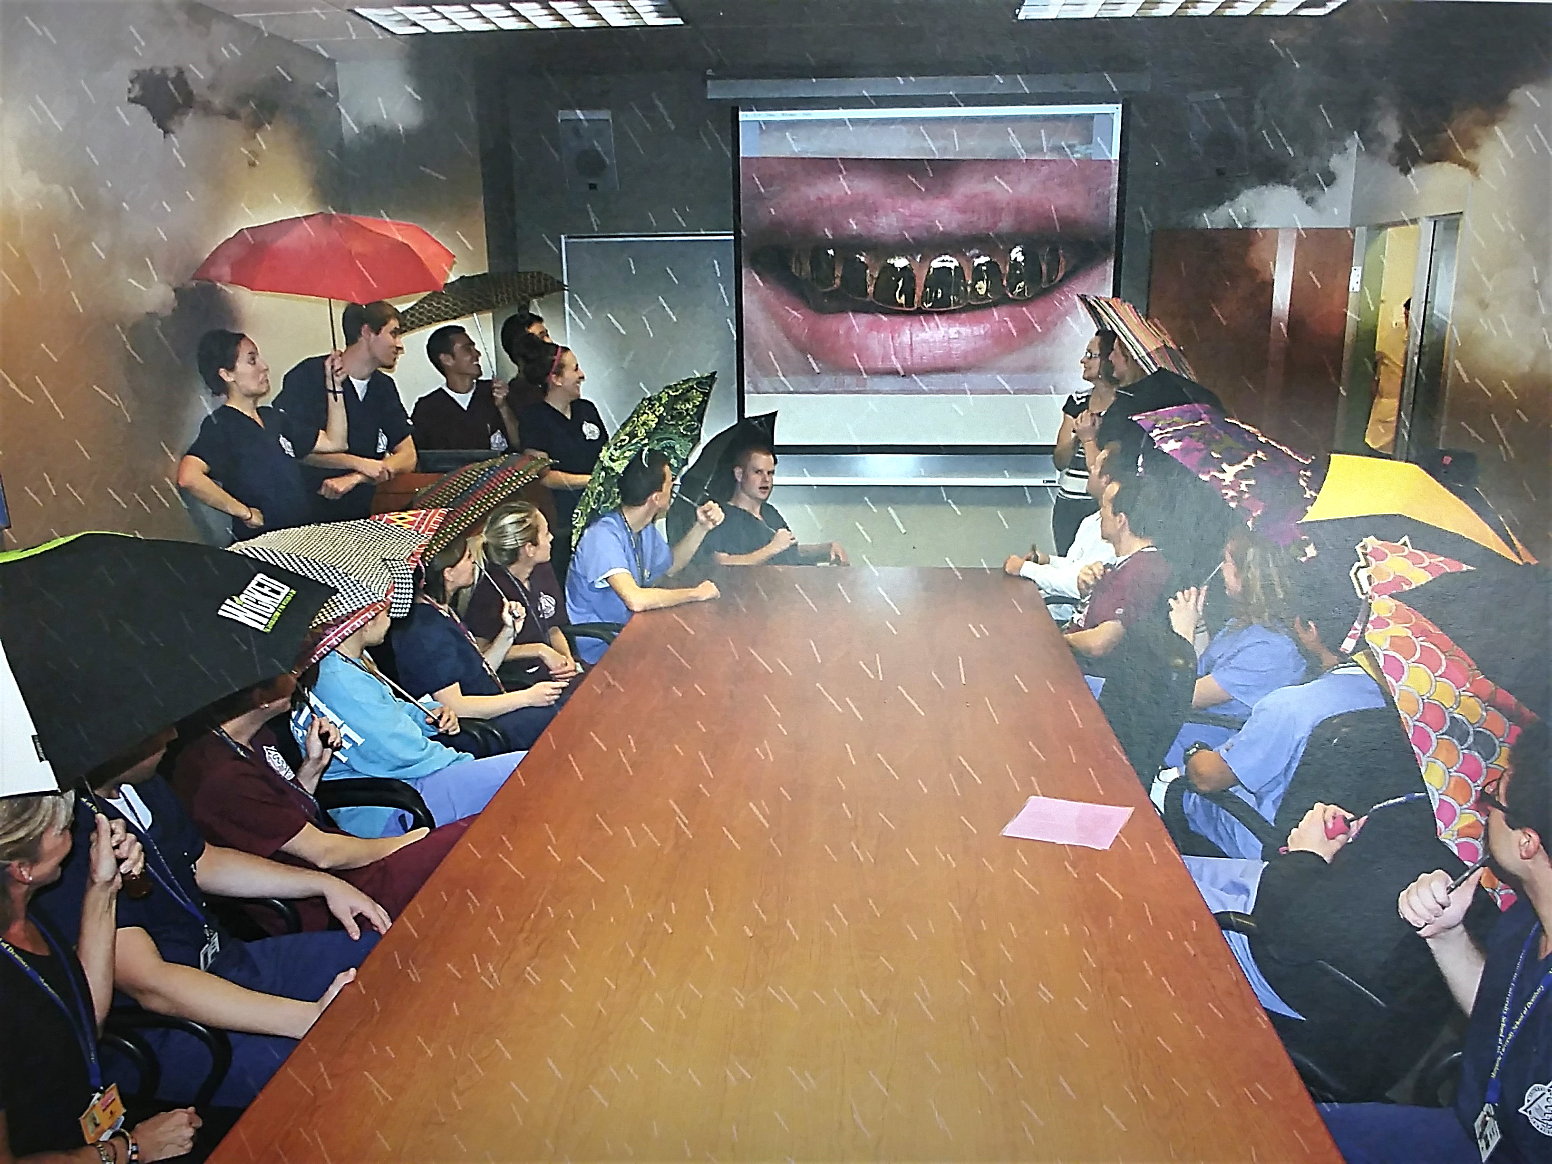
QUESTIONS?
April -- MUSoD Calendar 2014

Slide 22
Thank you!
Mary A. Cimrmancic, DDS
Room 336 HH
288-0791
Mary.Cimrmancic@Marquette.edu

Slide 23
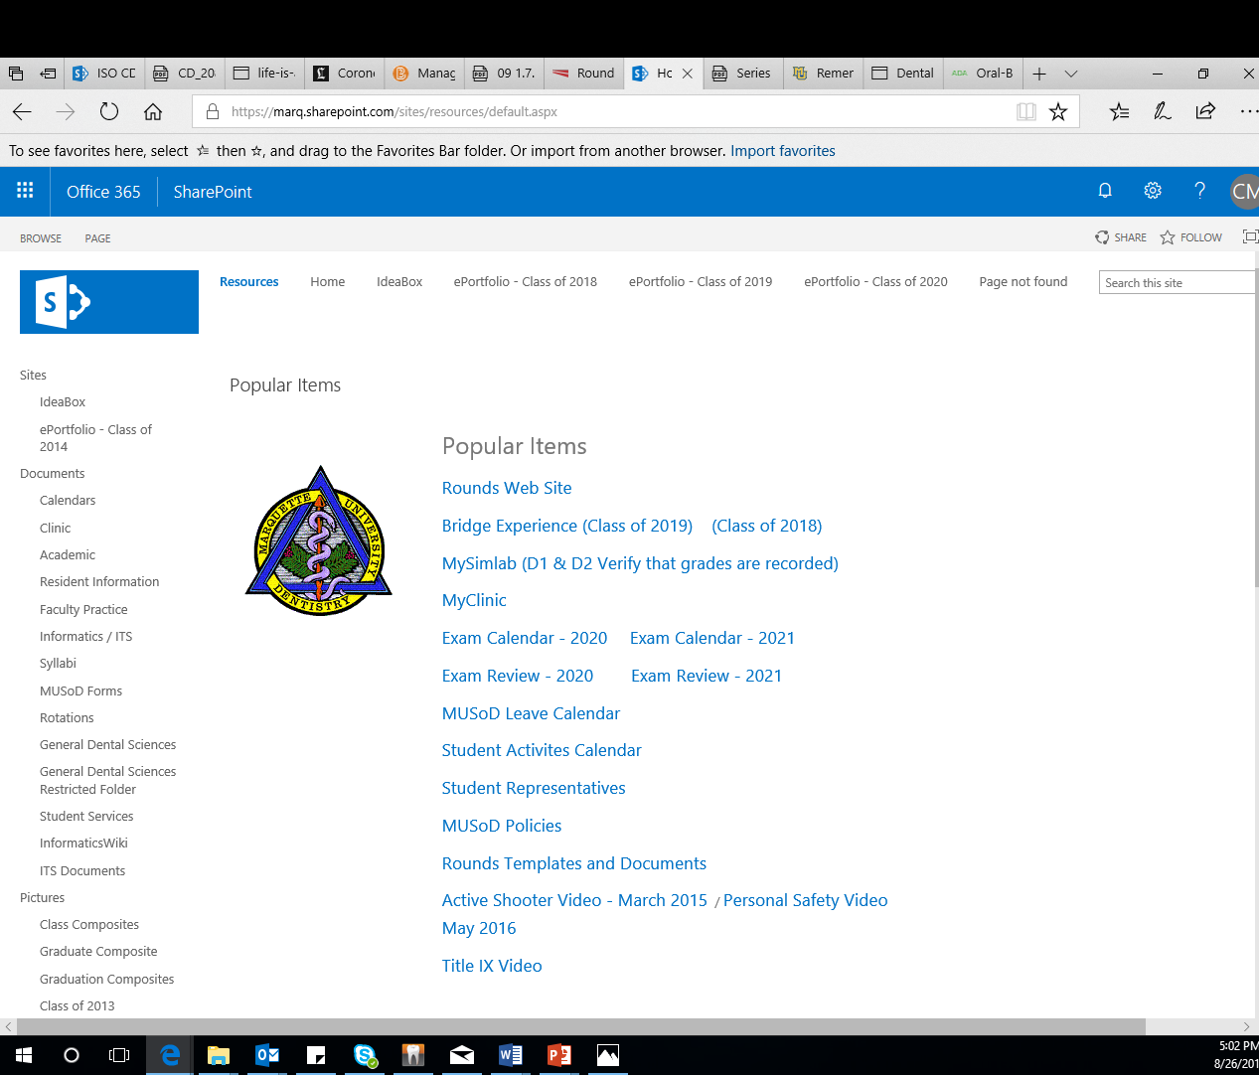
SharePoint

Slide 24
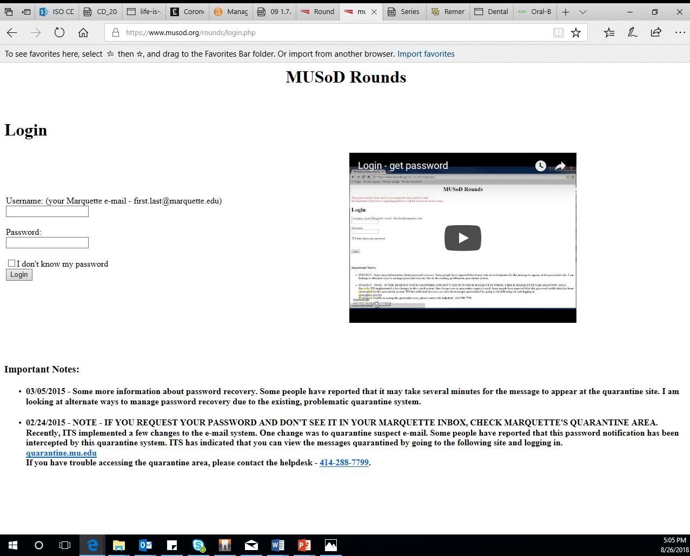

Slide 25
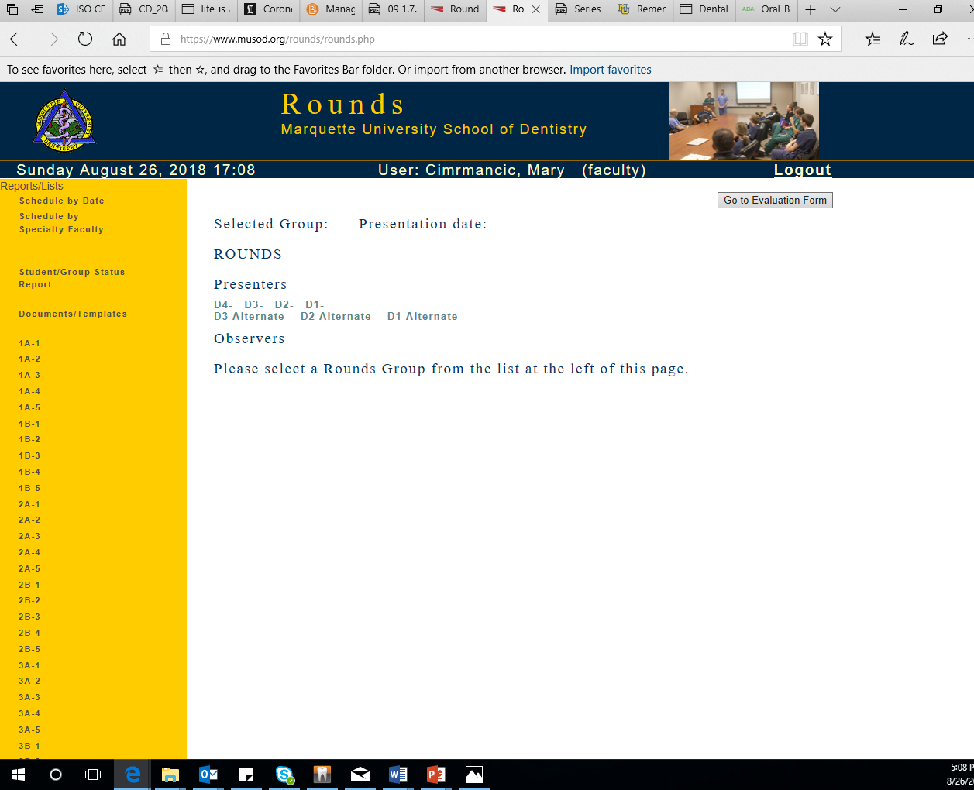


Slide 26
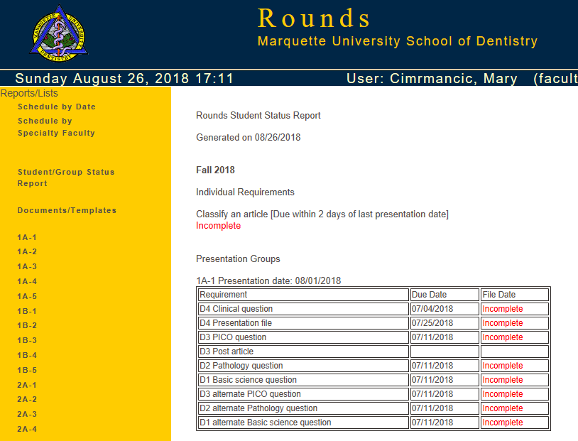

Slide 27
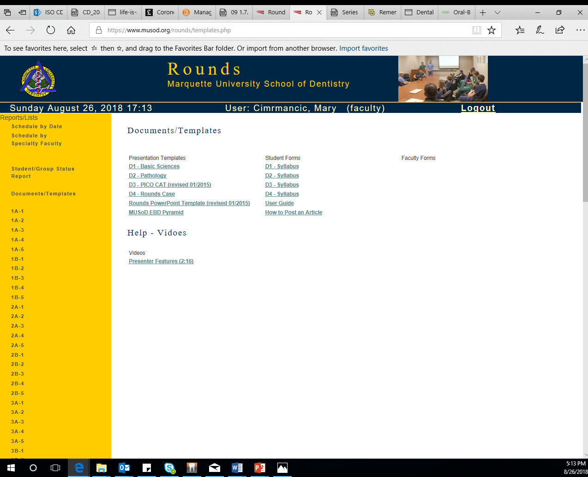
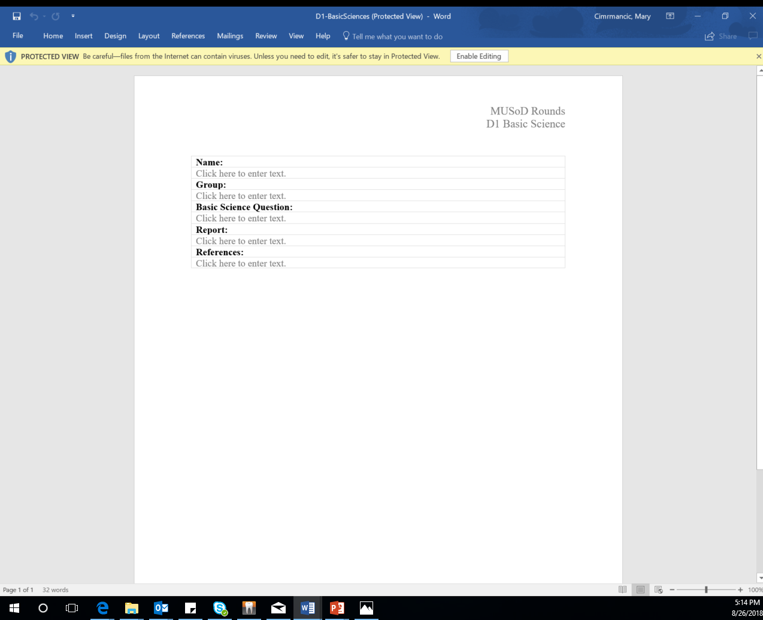
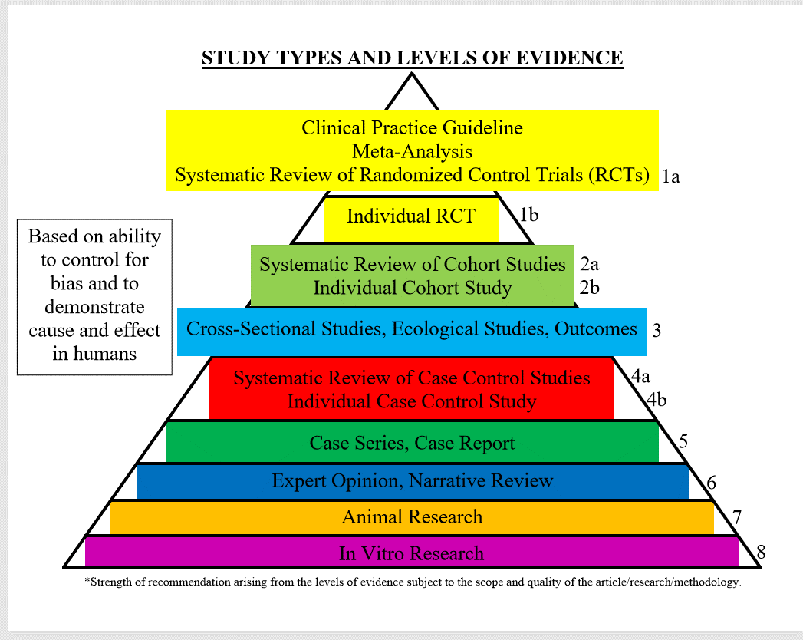

Slide 28
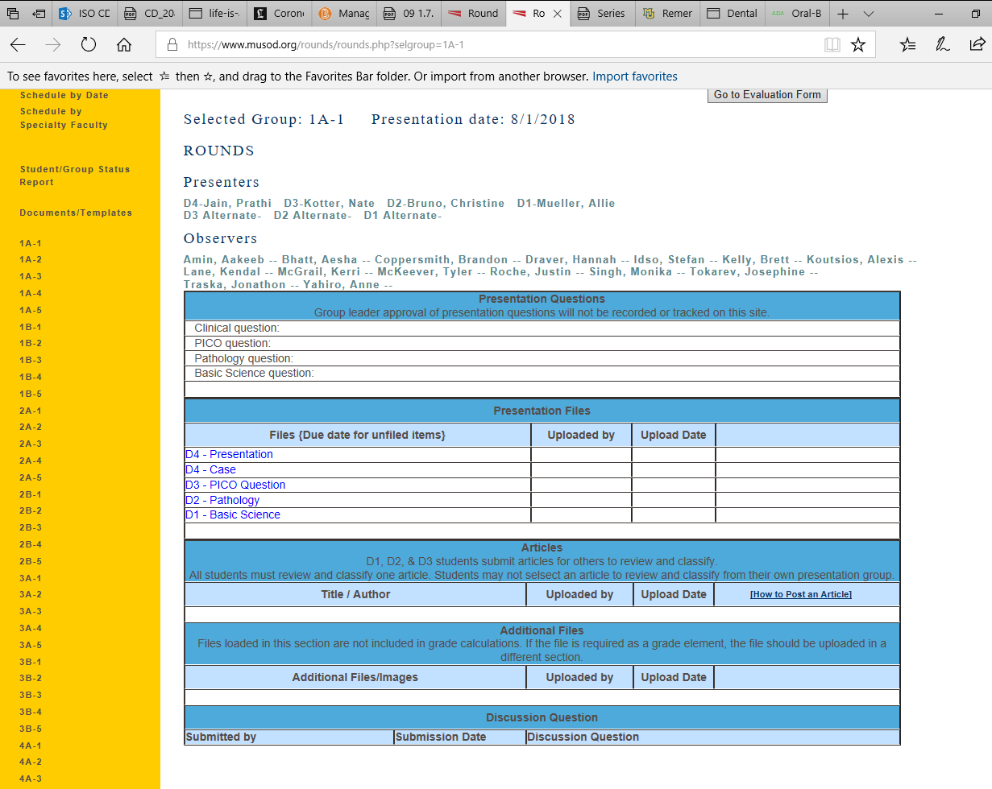

Slide 29
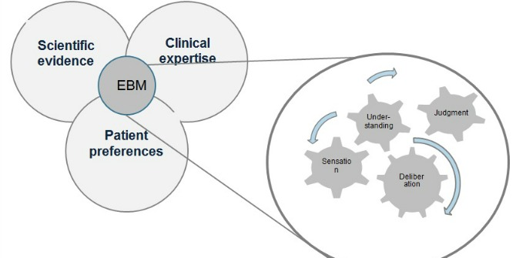
What is Evidence Based Dental Practice?
This Photo by Unknown Author is licensed under CC BY

